Slide 1
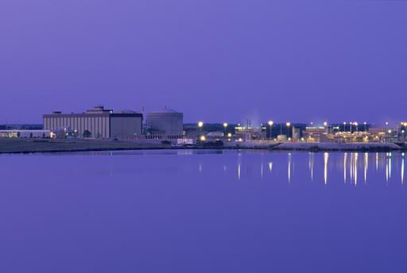
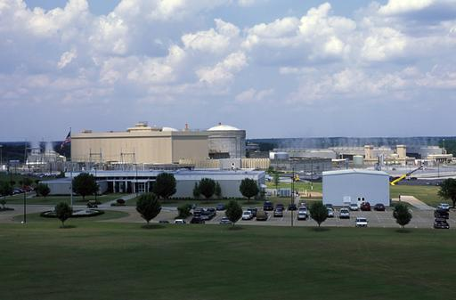
Teaching Nuclear Safety Culture
Charles C. Thebaud, Jr.
Paul J. Zaffuts
2011

Slide 2
Introduction
DOE continues to emphasize safety culture awareness and improvement throughout the complex.
Managerial / supervisory training of safety culture principles is an essential component of an improvement program.
Discuss use of engaging, real-world examples and case studies as an effective training method to introduce DOE contractor management to safety culture, best practices, and how to recognize and respond to warning flags of a degraded safety culture.

Slide 3
Objectives of Introductory
Safety Culture Training
Understand the definition of nuclear safety culture and the role that it plays in ensuring safe operations.
Understand nuclear safety culture principles and the consequences of a degraded safety culture.
Understand day-to-day responsibilities in promoting a strong nuclear safety culture.
Apply nuclear safety culture principles when supervising the workforce.

Slide 4
Teaching Methods
Limit straight lecture and encourage (require) participant interaction.
Each safety culture principle is illustrated with various findings / events from two significant non-nuclear events: the Columbia accident, and the Deepwater Horizon explosion.
  Participants make these examples more meaningful to them by identifying and discussing their own experiences, and drawing relationships to nuclear-related situations.
  Instructors’ experience with nuclear safety culture helps guide these discussions.
Tangible concrete responsibilities and day-to-day actions are presented which emphasize:
  Communication
  Decision-making
  Perceptions

Slide 5
Teaching Methods
Participants then apply nuclear safety culture principles to challenging, real-world supervisory scenarios taken from actual events.
  Class breaks into small groups (~5 student per group).
  Assign one case study to each group.
  Group analyzes case and prepares answers to discussion questions.
  Class reconvenes and groups present their analyses.
  Instructor challenges the participants to draw relationships between the facts and communications, decision-making, perceptions, and responsibilities.

Slide 6
Definition
Nuclear Safety Culture
An organization’s values and behaviors modeled by its leaders and internalized by its members, which serve to make safe performance of work the overriding priority to protect the workers, public, and the environment.
EFCOG/DOE ISMS Safety Culture Task Team Final Report

Slide 7
History
Challenger (1986) –Public investigation found NASA safety decisions emphasized “production.”
Millstone(1996) – Extended (2½ years) outage to demonstrate the existence of a SCWE.
Davis-Besse (2002) – Focused attention on nuclear safety culture.
Columbia (2003) – NASA safety culture flaws reappear demonstrating the difficulty of culture change.
Deepwater Horizon (2010) – Poor safety culture found to be a contributor to the disaster.

Slide 8
The Secretary of Energy on Safety Culture
DOE views nuclear safety and assuring a robust safety culture as essential to the success of … all of our projects across the DOE complex.
DOE committed itself to establishing and maintaining a strong nuclear safety culture almost 20 years ago ….
This commitment was reiterated and confirmed in February 2011, in DOE Policy 420.1, Department of Energy Nuclear Safety Policy.
Establishment of a strict safety culture must be a fundamental principle throughout the DOE complex,
Reinforcing and maintaining a strong safety culture at … all DOE sites will require a wide range of approaches ….
76 Fed. Reg. 42686 (June 19, 2011)

Slide 9
SCWE vs. Safety Culture
Safety Culture
SCWE
10 CFR 708

Slide 10
Safety Culture Attributes (DOE)
Leadership
  Clear expectations and accountability
  Management engagement and time in field
  Risk-informed, conservative decision-making
  Open communication and fostering an environment free from retribution
  Demonstrated safety leadership
  Staff recruitment, selection, retention, and development
Employee/Worker Engagement
  Personal commitment to everyone’s safety
  Teamwork and mutual respect
  Participation in work planning and improvement
  Mindful of hazards and controls
Organizational Learning
  Performance monitoring through multiple means
  Use of operational experience
  Trust
  Questioning attitude
  Reporting errors and problems
  Effective resolution of reported problems

Slide 11
Safety Culture “Principles”
Leaders demonstrate commitment to safety.
Nuclear safety is
everyone’s
responsibility.
Organizational
learning is embraced
Decision-making
reflects
safety first.
SAFETY
CULTURE
A “what if” approach
is cultivated.
Nuclear is recognized as different.
Nuclear safety undergoes constant examination.
Trust permeates the organization.
INPO “Principles for Strong Nuclear Safety Culture”
INPO “Principles for Strong Nuclear Safety Culture

Slide 12
Personal Responsibility for Nuclear Safety
INPO:
Support groups understand their roles and contributions to nuclear safety.
Ensure that all personnel understand the importance of adherence to nuclear safety standards.
The system of rewards and sanctions is aligned with strong nuclear safety policies and reinforces desired behavior and outcomes.
Treat people as the organization’s most valuable asset. Ensure that staffing levels are consistent with demands.

Slide 13
Columbia
January 16, 2003

Slide 14
Personal Responsibility for Nuclear Safety
Structure and hierarchy represent power and status. [E]mployees’ positions in the organization determined the weight given to their information, by their own judgment and in the eyes of others. As a result, many signals of danger were missed.
Relevant information that could have altered the course of events was available, but was not presented.
Early in the Challenger teleconference, some engineers who had important information did not speak up. They did not define themselves as qualified because of their position … they assumed others more involved in key discussions would have.
Columbia Accident Investigation Board

Slide 15
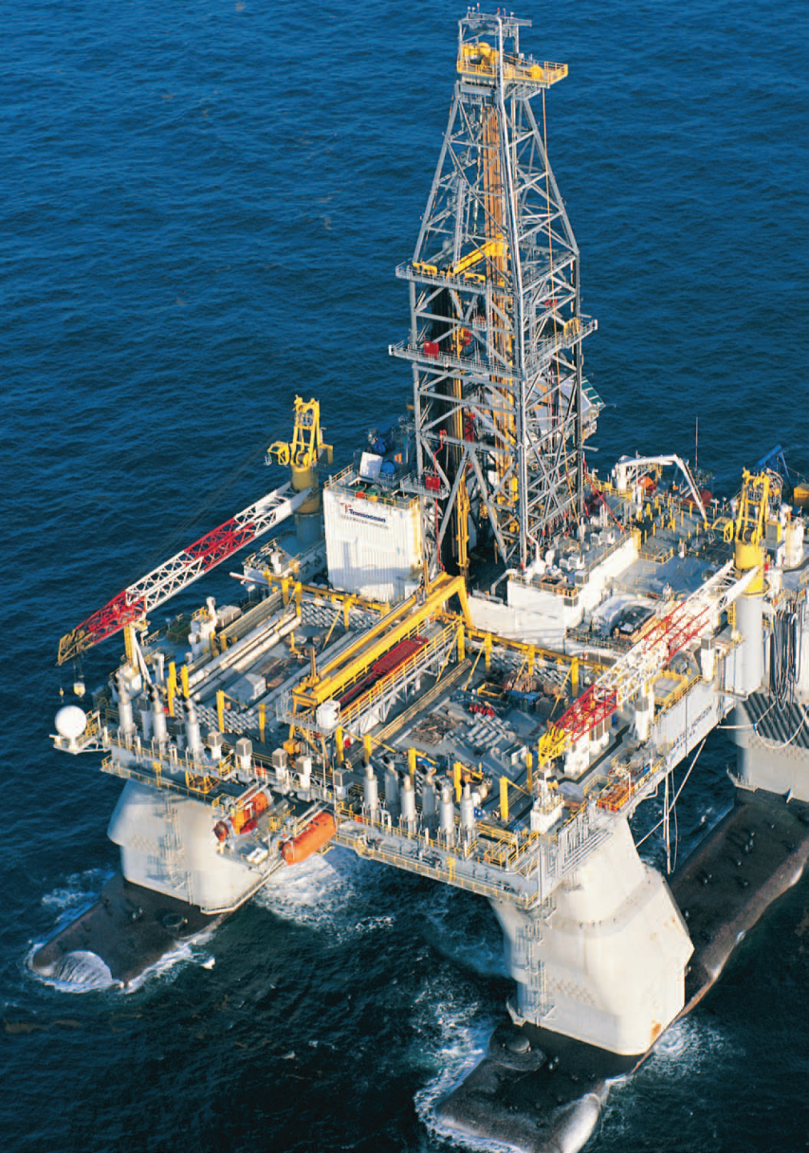
Deepwater Horizon
April 20, 2010

Slide 16
Personal Responsibility for Nuclear Safety
[D]rill-pipe pressure began slowly increasing, despite the fact that the pump rate remained constant. … [h]ad someone noticed it. … The crew may have been distracted by other matters.
[M]any BP and Halliburton employees were aware of the difficulty of the primary cement job. But those issues were for the most part not communicated to the rig crew.
BP Well Site Leaders did not consult anyone on shore about the anomalous data observed … Had they done so, the Macondo blowout may not have happened.
National Commission on the BP Deepwater Horizon Oil Spill

Slide 17
Leaders Demonstrate Commitment to Safety
INPO:
Communicate the nuclear safety message frequently and consistently, occasionally as a stand-alone theme.
Practice visible leadership in the field.
Consider the employee’s perspective.
Explain the bases, expected outcomes, potential problems, planned contingencies, and abort criteria for important operational decisions.
Encourage informal opinion leaders to model safe behavior and influence their peers.

Slide 18
Leaders Demonstrate Commitment to Safety
Consider a person’s contribution to nuclear safety when selecting supervisors and managers.
Recognize that production goals and schedules can send mixed signals, if not properly communicated.

Slide 19
Leaders Demonstrate Commitment to Safety
Managers also failed to develop simple contingency plans for re-entry emergency. They were convinced, without study, that nothing could be done about such an emergency.
Columbia Accident Investigation Board
[T]he workforce has received a conflicting message due to the emphasis on achieving cost and staff reduction, and the pressures placed on increasing scheduled flights as a result of the Space Station.
Space Shuttle Independent
Assessment Team - - 1999

Slide 20
Leaders Demonstrate Commitment to Safety
BP’s management process did not adequately identify or address risks created by late changes to well design and procedures.
[I]ndividuals often found themselves making critical decisions without a full appreciation for the context in which they were being made.
National Commission on the BP Deepwater Horizon Oil Spill

Slide 21
Trust Permeates the Organization
INPO:
Concentrate on timely, accurate communications.
Treat all persons with dignity and respect.
Encourage and address all safety concerns and different or opposing views.
Plan for and manage change.
Tell the workers the reasons for important decisions.
Avoid retaliation and the perception of retaliation.

Slide 22
Trust Permeates the Organization
Deficiencies in communication…were a foundation for the Columbia accident.
Over time, a pattern of ineffective communication has resulted, leaving risks improperly defined, problems unreported, and concerns unexpressed.
Columbia Accident Investigation Board

Slide 23
Trust Permeates the Organization
BP did not share important information with its contractors, or sometimes internally even with members of its own team. Contractors did not share important information with BP or each other.
46 percent of crew members surveyed felt that some of the workforce feared reprisals for reporting unsafe situations.
National Commission on the BP Deepwater Horizon Oil Spill

Slide 24
Decision-making Reflects Safety First
INPO:
Use a rigorous approach to problem solving.
If your information or understanding of the problem is incomplete, choose the conservative action.
Use single-point accountability for important safety decisions and allow for ongoing assessment and feedback as circumstances unfold.
Seek candid dialogue and debate. Expect a robust decision and healthy conflict.
Distinguish between an “allowable” choice and a prudent choice.
Review such decisions and assumptions when new facts arise.

Slide 25
Decision-making Reflects Safety First
The initial damage assessment briefing prepared for the Mission Evaluation Room was cut down considerably in order to make it “fit” the schedule. Even so, it took 40 minutes. It was cut down further to a three-minute discussion topic at the Mission Management Team….
Mission Management Team participants felt pressured to remain quiet unless discussion turned to their particular area of technological or system expertise, and, even then, to be brief.
Columbia Accident Investigation Board

Slide 26
Decision-making Reflects Safety First
[C]ompanies involved must have in place strict policies requiring rigorous analysis and proof that less-costly alternatives are in fact equally safe. If BP had any such policies in place, it does not appear that its Macondo team adhered to them.
Decision making processes at Macondo did not adequately ensure that personnel fully considered the risks created by time- and money-saving decisions.
[O]fficials made a series of decisions that saved BP, Halliburton, and Transocean time and money—but without full appreciation of the associated risks.
BP has provided no evidence that it … has ever set a surface cement plug so deep in seawater … No evidence … that the BP team ever formally evaluated these options or the relative risks created.
National Commission on the BP Deepwater Horizon Oil Spill

Slide 27
Recognize That Nuclear Technology is Unique
INPO:
Conduct activities that could affect the core with particular care and caution.
Pay special attention to core cooling, fission product barriers, and defense in depth.
Work in accordance with high-quality processes and procedures.

Slide 28
Recognize That Nuclear Technology is Unique
By their very nature, high-risk technologies are exceptionally difficult to manage.
The risks inherent in those technical systems are heightened when they are produced by and operated by complex organizations that can also break down in unanticipated ways.
Columbia Accident Investigation Board

Slide 29
Recognize That Nuclear Technology is Unique
BP’s fundamental mistake was its failure — to exercise special caution (and, accordingly, to direct its contractors to be especially vigilant) before relying on the primary cement as a barrier to hydrocarbon flow.
[T]here is nothing to suggest that BP’s engineering team conducted a formal, disciplined analysis of the combined impact of these risk factors ….
National Commission on the BP Deepwater Horizon Oil Spill

Slide 30
Cultivate a Questioning Attitude
Encourage workers to challenge assumptions.
Encourage workers to identify conditions that have the potential to affect safety.
Investigate anomalies.
Recognize the possibility of mistakes, and equipment failures, make constructive decisions and develop contingencies.
Avoid group think; encourage opposing views.

Slide 31
Cultivate a Questioning Attitude
At every juncture of STS-107 … the managers in charge, resisted new information.
[A] leader’s best response to unanimous consent is to play devil’s advocate and encourage an exhaustive debate. Mission Management Team leaders failed to seek out such minority opinions. Imagine the difference if any Shuttle manager had simply asked, “Prove to me that Columbia has not been harmed.”
NASA’s blind spot is it believes it has a strong safety culture.
Columbia Accident Investigation Board

Slide 32
Cultivate a Questioning Attitude
Wheeler was “convinced that something wasn’t right,” … Wheeler couldn’t believe the explanations he was hearing. But his shift was up.
[T]he drill pipe … continued to show elevated pressure. … Anderson said he had seen this before and explained away the anomalous reading ….
[F]ront line crews are potentially working with a mindset that they believe they are fully aware of all the hazards when it’s highly likely that they are not.”
National Commission on the BP Deepwater Horizon Oil Spill

Slide 33
Embrace Organizational Learning
INPO:
Build nuclear safety values into training.
Review and learn from significant industry and station events. (Use Operating Experience.)
Apply root cause expertise to identify and correct fundamental causes of events.
Prioritize and resolve issues with nuclear safety implications in a timely manner.
Avoid complacency and cultivate a continuous learning environment. (Recognize that it can happen here.)

Slide 34
Embrace Organizational Learning
NASA’s safety culture has become reactive, complacent, and dominated by unjustified optimism.
NASA emphasizes safety…, but training programs are not robust and methods of learning from past failures are informal.
Columbia Accident Investigation Board
The Shuttle Program was inappropriately using previous success as a justification for accepting increased risk.
Space Shuttle Independent Assessment Team - - 1999

Slide 35
Embrace Organizational Learning
Absent major crises, and given the remarkable financial returns available from deepwater reserves, the business culture succumbed to a false sense of security.
The Deepwater Horizon disasterexhibits the costs of a culture of complacency.
BP’s investigation system has not instituted effective root cause analysis procedures to identify systemic causal factors.
Transocean failed to adequately communicate to its crew lessons learned from an eerily similar near-miss on one of its rigs in the North Sea four months prior to the Macondo blowout.
National Commission on the BP Deepwater Horizon Oil Spill

Slide 36
Constantly Examine Nuclear Safety
INPO:
Use both self assessments and oversight to strengthen safety and improve performance.
Recognize that a focus on a narrow set of performance indicators may be misleading.
Seek fresh perspectives provided by quality assurance, employee concerns, and similar groups.

Slide 37
Constantly Examine Nuclear Safety
NASA’s safety and mission assurance organization was not sufficiently independent.
Space Shuttle Independent Assessment Team - - 1999
The safety personnel present … were largely silent during the events leading up to the loss of Columbia. That silence was not merely a failure of safety, but a failure of the entire organization.
Columbia Accident Investigation Board
When the space shuttle Columbia launched on January 16, 2003, there were 3,233 Critically 1/1R critical item list hazards that were waived. (Failure of a Criticality 1/1R component will result in loss of the Orbiter and crew.)
U.S. Department of Energy, Lessons Learned
From the Columbia Space Shuttle Accident

Slide 38
The Supervisor’s Safety Culture Role:
A Summary
Understand and follow site policies and expectations and hold personnel accountable.
Provide sufficient resources and time to perform tasks in a safe and conservative manner.
Do not accept recurring equipment or personnel problems.
Seek first-hand information.
Observe work and provide feedback.
Remain open, honest, and consistent in communications.

Slide 39
Case Studies

Slide 40
Case Study Example
Schedules for completing design work on certain important equipment have been tightened over the last 6 months.
Pam, an experienced engineer, has been increasingly vocal about this and, during a weekly staff meeting, stood up and argued forcefully that the schedules were negatively impacting the quality of the team’s work.
When her supervisor told her to sit down so that he could finish the meeting, she stated that it was clear that management did not care about quality and uttered a number of expletives while storming out of the room.

Slide 41
Example Case Study:
Discussion Questions
What effect will the supervisor’s conduct have on the workgroup’s willingness to raise concerns in the future?
What actions could the supervisor have taken in the past to avoid Pam’s outburst?
Actions during the meeting?
Should the supervisor discipline Pam for her behavior?
What would you say to Pam if you were the supervisor?
If you were the supervisor, how would you turn this event around and recapture the workgroup’s trust?
Should any level of unprofessional conduct be tolerated in raising concerns?
Would your answer change if Pam had previously raised meritorious claims that management failed to adequately address?

Slide 42
Nuclear Safety Culture
CONCLUSION
Focus on the Principles For a Strong Nuclear Safety Culture.
Doing so will:
    Enhance safety; and
    Improve performance.

