Slide 1
Department of Energy
Developments in Contractor Human Resources
Jean Seibert Stucky
Assistant General Counsel for Contractor Human Resources, and
Labor Compliance Advisor
Jean.Stucky@hq.doe.gov
202-586-7532
Presentation to the DOE Contractor Attorneys’ Association July 22, 2016

Slide 2
Developments in Contractor Human Resources
Executive Order (EO) 13673: Fair Pay and Safe Workplaces
Recent Developments: (1) Joint Employment, (2) The Perfectly-Clear Successor, and (3) Pro-force Bargaining Units and Determination of Supervisory Status
DOE Contractor Defined Benefit Pension and Health Benefit Plans

Slide 3
Executive Order (EO) 13673:
Fair Pay and Safe Workplaces

Slide 4
Executive Order 13673
EO 13673 (7/31/14, 12/11/14) was designed to increase efficiency/cost savings in government contracting by ensuring that Federal contractors understand and comply with labor laws.
  Disclose compliance issues: EO applies to all contracts and subcontracts (other than COTS) larger than $500,000.
    Offerors and contractors report civil judgments, arbitral awards/decisions, and administrative merits determinations for 14 named laws and equivalent State laws.
    Covered subcontractors must report same information to Department of Labor.
  Assess disclosures: Contracting Officers, in consultation with Agency Labor Compliance Advisors (ALCAs), take compliance information into account in making responsibility determinations.
  Provide assistance: Help contractors come into compliance with labor laws.

Slide 5
Executive Order 13673: Proposed Final Rule
The EO and proposed rule:
  Do not apply to contracts and subcontracts less than $500,000
    Likely to exclude many contracts
    Intended to limit impact on small businesses.
  Are not intended to blacklist contractors
    Rule’s goal is to correct violations and help bring contractors into compliance.
  Are not intended to disrupt procurement process
    Contractors are encouraged to engage in pre-assessment process with Department of Labor (DOL), contracting, and enforcement agencies where they are concerned about potential labor law violations.
  Phase-in for EO requirements.

Slide 6
Executive Order 13673: Evaluation of Disclosures
Will consider all the facts and circumstances surrounding violations, including mitigating factors offered by contractor/subcontractor –
  Number of violations
    Total number
    Number relative to size of the contractor/subcontractor
  Repetitive violations of same or similar requirement
  Seriousness of violation
    Number of employees affected, degree of risk involved, or actual harm done
  Whether contractor/subcontractor acted in good faith/reasonably and without knowledge of, reckless disregard for, or indifference to labor violation

Slide 7
Executive Order 13673: Mitigating Factors
Factors considered in evaluating contractor responses
  All information contractor/subcontractor deems necessary to demonstrate responsibility
  Mitigating factors or remedial measures
    Actions taken to address violations
    Labor compliance agreements
    Other steps to achieve compliance
  Examples:
    Implementation of a safety and health management program
    Collectively-bargained grievance procedure
    Long period of compliance following the violations

Slide 8
Executive Order 13673: Situation at DOE
DOE already does a lot of this.
Contractors will be held accountable in award fee determinations for their performance in this regard.
  Most fee determinations already take into account competent business management.
  And, that in our view certainly includes management of labor and benefits.

Slide 9
Recent Developments:
Joint Employment

Slide 10
Browning-Ferris Industries,
362 NLRB No. 186 (Aug. 27, 2015)
Two legally-separate entities will be considered joint employers if – (1) they both constitute employers of the employees at issue within the meaning of the common law, and (2) the putative joint employer possesses the right of control over the employees’ terms and conditions of employment (T&C) as to co-determine T&C.
  The bare right of control, never exercised, may not be enough, depending on the extent and nature of the retained control.

Slide 11
Miller & Anderson, Inc.,
364 NLRB No. 39 (July 11, 2016)
The National Labor Relations Board requires an employer to bargain in a single employer bargaining unit if those employees share a substantial community of interest.
Where, however, a union seeks to bargain with several different employers, the consent of those employers to a multiemployer unit is required, even if the employees share a substantial community of interest.
Miller & Anderson, supra: Where a single user employer obtains employees from a supplier employer (such as a staffing agency) and a union seeks to represent (i) the individuals jointly employed by the user and the supplier employer and (ii) the user’s solely employed employees in a single bargaining unit – that unit does not constitute a multiemployer unit and consent of the employers is not required, if the user and supplier employers constitute a joint employer and the employees share a substantial community of interest.
  The employers had stipulated to the existence of a joint employer relationship.

Slide 12
Joint Employer Concepts and the Fair Labor Standards Act (FLSA)
Administrator David Weil of the Department of Labor’s Wage and Hour Division issued an Administrator’s Interpretation on joint employment under the FLSA (1-20-16).
  The concept of “employ” is broadly defined under the FLSA as “to suffer or permit to work,” i.e., to have the reasonable ability to know that work was performed and to prevent performance of the work.
  Weil emphasized that, in contrast to the common law National Labor Relations Act (NLRA) definition centered on control, the FLSA definition of an employer (and joint employer) has always included employers that receive the benefits of the employee’s work or upon which the employee is economically dependent.

Slide 13
Recent Developments:
The Perfectly-Clear Successor

Slide 14
NLRA Successor Employers
An employer who acquires the operations of another (for example, a contractor that wins a DOE contract) may succeed to its predecessor’s obligation to recognize and bargain with the union that represented the predecessor’s employees if –
  (1) It continues operations in substantially the same form and
  (2) A majority of the employees it hires were employees of the predecessor
An employer is not legally obligated by the NLRA to hire its predecessor’s employees; however, if the new employer discriminates against those employees in hiring, the Board will presume that – but for that discrimination – a majority of its employees would have been employees of the predecessor and the new employer will lose the right to set initial T&C.

Slide 15
NLRA Successorship in the Context of
DOE Contract Transitions
Consistently since February 1995, DOE has taken the position that the new contractor will generally succeed to the bargaining obligations of its predecessor, even in circumstances where the operations are converting from production to clean up –
  Extensive hiring preferences for the existing workforce.
  It may reasonably be assumed that the employees’ desires concerning union representation are likely unchanged.
    Same general location, same customer (DOE), and many of the same supervisors.
    The work may have begun to change before the contract transition.
    The work of the new employer probably calls for familiarity with the safety hazards of the site and many of the same basic skills.

Slide 16
The “Perfectly Clear” NLRA Successor
Generally, a successor employer can unilaterally set initial T&C, unless it is “perfectly clear” that it plans to retain all the employees in the bargaining unit, and the successor either failed to make it clear that it would change T&C or it misled employees into believing they would be employed without any such changes.
  Requiring the new employer to initially consult before setting T&C is different than requiring adoption of the existing CBA.
In GVS Properties, Inc., 362 NLRB No. 194 (August 27, 2015), the Board held that employers subject to worker retention statutes may “avoid ‘perfectly clear’ successor status by announcing new terms and conditions of employment prior to or simultaneously with the expression of intent to retain their predecessors’ employees.”
  DOE contracts include not only extensive hiring preferences (stemming from FAR Part 52, Section 3161, etc.), but also extensive protections for continuity of wages and benefits.

Slide 17
The “Perfectly Clear” NLRA Successor (cont’d)
In a memo to his field offices on February 25, 2014, the NLRB GC announced that
  where it is “perfectly clear” that the new employer will succeed to bargaining obligations,
  the issue of whether the new employer is obligated to bargain with the union before setting initial T&C must be submitted to him for review,
    and emphasized that such issues represent his highest policy concern or initiative.

Slide 18
Successorship under Section 4(c) of Service Contract Labor Standards (formerly known as SCA)
Under Section 4(c) –
  The successor contractor's sole obligation is to ensure that all service employees are paid no less than the wages and fringe benefits (not seniority, grievance procedures, work rules, overtime, etc.).
    Where there is a 4(c) successor contractor, the wage rates and fringe benefits are set forth in the pertinent collective bargaining agreements for bargaining unit employees.
  In contrast to the NLRA successorship doctrine, the 4(c) CBA wage determination applies irrespective of whether the successor's employees were or were not employed by the predecessor contractor.

Slide 19
Recent Developments: Pro-force Bargaining Units and Determination of Supervisory Status

Slide 20
Guards Bargaining Units and Supervisory Status Determinations
WSI Savannah River Site and International Guards Union of America, 363 NLRB No. 113 (2/10/16).
  In 2014, approximately 75 sergeants and lieutenants petitioned to unionize.
  Board affirmed NLRB Regional Director determination that the sergeants and lieutenants were not supervisors and therefore they were properly included in the bargaining unit.
    Supervisors may not unionize under Section 2(11) of the NLRA if they perform any of the enumerated functions using independent judgment.

Slide 21
WSI Savannah River Site (cont’d)
There was no evidence that the supervisors used independent judgment in the exercise of any of the supervisory indicia –
  No responsible direction (were not held accountable for subordinates’ failings).
  No independent judgment in the assignment function; standard policies and procedures controlled their exercise of judgment regarding changes in T&C.
  All discipline was approved by labor relations.
NLRB representation case decisions are not final agency orders from which appeal may be taken directly to the circuit courts of appeal.
  Sole recourse is to “test certification” by violating the NLRB’s order to bargain on the basis that the NLRB’s certification of a union of supervisors violates the NLRA.
  Very difficult to prevail in such a case given courts’ deference to NLRB expertise.

Slide 22
DOE Contractor Defined Benefit Pension and Health Benefit Plans*
    as of April 2016
    * As reported in DOE’s FY2015 Agency Financial Report

Slide 23
DOE’s Liabilities*
DOE contractor employees (especially the technical workforce) are increasingly older, longer service.
  Benefits are critical to DOE CHR management.
  Benefits like those of our biggest contractors are designed to hold on to employees.
    How does this line up with EM’s shorter duration projects?
FY2015 Net Funded Status of Contractor DB Pension and post-retirement benefit (PRB) Plans has somewhat deteriorated, but much of the deterioration is due to lower investment return than anticipated and changes in participant demographic assumptions.
DBs -$16B
PRBs -$10.2B
-$26.2B**
* As reported in DOE’s FY2015 Agency Financial Report.
**Up from -$23.3B in FY2014. By comparison, DOE’s FY2016 enacted budget is $29.6B.

Slide 24
Funded Status of Defined Benefit (DB) Pension Plans
DOE contractors sponsor approximately 32 DB pension plans, of which they are also the fiduciaries.
In plan year 2016, the funded status of DOE contractor DB pension plans is estimated to range from approximately 75% to 140%.
  NB: The current funded status is heavily influenced by legislative relief for interest rates to discount the future liabilities of the plans for funding and certification.
  No DOE contractor plans are considered endangered for 2016.

Slide 25
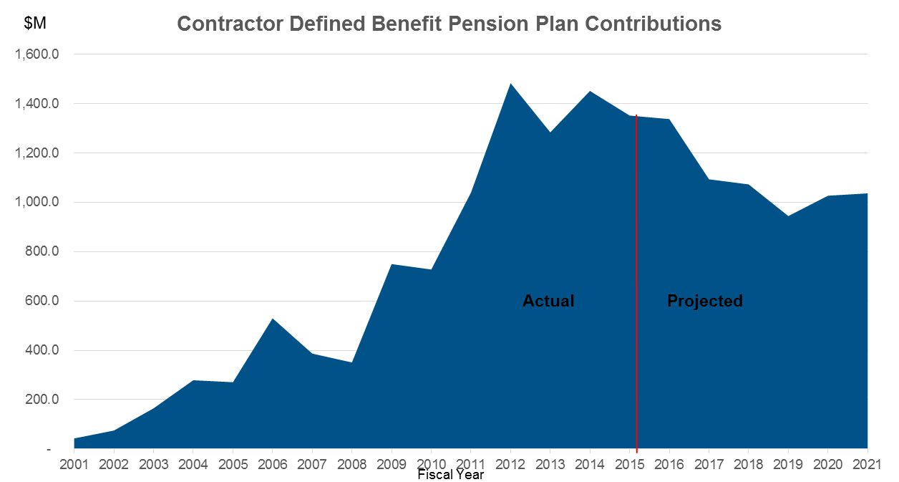
Contractor Pension Contributions
Contributions have steadily increased due to increased funding requirements of the 2006 Pension Protection Act and the market collapse of 2008/2009.
Current projections suggest that contributions may decline in the future as the plans become better funded, but many things could change such projections.

Slide 26
Recent Changes to DB Pension Plans
Employee contributions for represented employees:
  Three groups of bargaining unit employees of Consolidated Nuclear Security will begin contributing 0.5% of compensation during 2016 which will increase over time to 1% of compensation.
    NB: Employees at LANL, LLNL, and LBNL already contribute approximately 7%.
Lump Sum Open Windows for Terminated Vested Participants (to reduce total plan liabilities):
  E.g., the Savannah River Nuclear Solutions LLC Multiple Employer Pension Plan was amended to permit terminated vested participants with lump sum values of less than or equal to $25,000 to elect an immediate lump sum.

Slide 27
Contribution Strategy: Plans Requesting Funds in Excess of the Minimum Required Contribution
Alternative Funding Strategies (AFS) - In accordance with the requirements of their contracts, contractors requested reimbursement of contributions in excess of the minimum for 17 contractor pension plans managed by NNSA, SC, NE, or EERE, and the Department has approved each of those requests.
  NNSA, SC, NE and EERE granted requests by contractors for reimbursement of contributions in excess of the minimum
    primarily to limit the volatility of pension plan contributions and
    to mitigate increases in future contribution requirements.
  If contributions were limited to the required minimum, the minimum required contributions could exceed the AFS scenario by 2019.

Slide 28
Contribution Strategy: Glide Path De-Risking Strategies
Glide Path De-Risking Strategies - Over the last few years, a number of contractors have adopted investment strategies designed to reduce the future volatility of plan contributions. These strategies, known as, Glide Path De-Risking Strategies, involve a decrease in equity investments and an increase in fixed income investments. Using these strategies, then, the asset values and liabilities values move together with changes in interest rates.
  The purpose of Glide Path De-Risking Strategies is to align asset and liability changes and minimize sudden, unexpected deteriorations in funded status.

Slide 29
“If you’re in, you’re in . . . ”
Incremental implementation of 2 tier market-based benefits
  Began in 1998 and was incorporated in all major acquisitions between 2005 and about 2009
  Plans were closed to new entrants, but
  The continued, active participation of eligible incumbent employees in DB pension plans was protected
  Plans were subject to amendment, with HQ approval
  New entrants were provided enhanced defined contribution (DC) benefits.
Last fall, Secretary Moniz issued a Statement that it was Departmental Policy to protect the rights of eligible incumbent employees to continue actively participating in the DB pension plans in which they have been participating.

Slide 30
BenVal Task Force and Its Recommendations
BenVal Task Force was convened to provide recommendations to the Secretary on how to ensure that DOE continues to attract and retain the best contractor employees while facilitating the achievement of DOE missions in a cost effective manner.
  representatives from NNSA, EM, SC, GC, CFO, and MA
Recommendations (from June 2016 memo) include:
  Excluding closed DB pension plans
  Not requiring corrective action plans for bargaining unit employees based solely upon BenVal results.
  Review and update of existing comparator groups.

Slide 31
Health Costs
Health costs are expected to be more significant than pension costs in the future. A moderate rise in healthcare costs is expected until employers have to begin responding to the Affordable Care Act Excise Tax (the “Cadillac Plan Tax”).
    Most DOE contractor health benefit costs continue to exceed external benchmarks.
    But, the movement to fixed subsidies and exchanges in place of existing DB medical plans has assisted cost reductions, while protecting benefits.
Retiree Health costs have made significant movement toward benchmarks, but remain above the benchmarks. Many plans are closed to new hires; however, since cash costs are “pay as you go,” there is little cost reduction in the near term.

